Slide 1


Slide 1
Using Data Science to solve Business Challenges in Restaurant Industry
Sheetal Joshi
April 2020

Slide 2

Slide 2
THE BIG IDEA
Using latest data on Restaurant Locations, Cuisines and Customer preferences to build a framework to predict success of a new Restaurant

Slide 3
Slide 3
INTRODUCTION
Restaurant industry is fiercely competitive.
In larger cities, people dine out very often and they have a lot of food options to choose from. Right from the choice of world cuisine to the type of restaurant ambience to the cost, there are multiple factors that can make a restaurant popular.
Business Problem Description
It has become increasingly difficult for new Restaurant owners to select the ‘type’ of restaurant cuisine or location to ensure business success. They cannot rely merely on intuition and need solid analysis of facts to make their decisions.
Restaurant goers have started depending heavily on Social media recommendations. The likes, reviews or ratings of a restaurant are an important success factor for any restaurant.
Hence, can Business owners leverage Social Media to solve practical business questions like –
Given a choice of Multiple Cities, which city may be the best for a new restaurant?
Within the city selected above, which type of cuisine will be a successful proposition?
Possible Solution using Social Media
Foursquare has immense data on restaurants, their locations and performance.
We can leverage the Foursquare API to compare performance (ratings/reviews) across cities and cuisines. For the purposes of this analysis, we will contain the geographical scope of analysis to three heavily populated cities in California, namely San Francisco, Los Angeles, and San Diego.
Leveraging this data will solve the problem as it allows the new business owner (or existing company) to make preemptive business decisions regarding opening the restaurant in terms of whether it is feasible to open one in this region and expect good social media presence, what type of cuisine and which city of three would be the best. This project will analyze and model the data via machine learning through comparing both linear and logistic regressions to see which method will yield better predictive capabilities after training and testing.

Slide 4

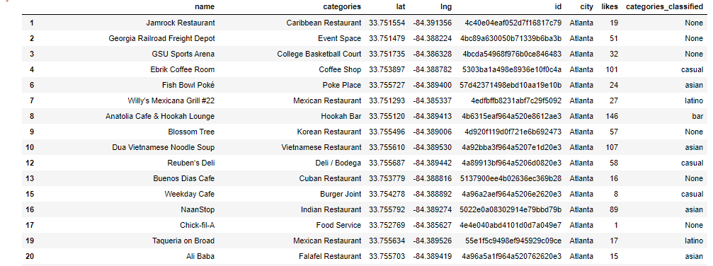
Slide 7
THE DATA
Restaurant demographics data used from Foursquare
Dataset formed for restaurants in 3 cities – Atlanta , Miami and Tampa
Data Set is processed to classify into different cuisine categories – Asian, Euro, Casual, Bar, American, Latino
Data is cleaned up to remove non-restaurant locations such as Supermarket, Bakery etc
Following is a sample

Slide 5
Slide 8
Regression Results
Linear Regression
A linear regression model was trained on a random subsample of 80% of the sample and then tested on the other 20%. To see if this is a reasonable model the residual sum of squares score, and variance score were both calculated (109477 and -0.07 respectively).
Given the low variance score, this is probably not a valid/good way of modelling the data. Therefore, we move on to logistic regression.
Logistic Regression
A multinomial ordinal logistic regression model was trained on a random subsample of 80% of the sample and then tested on the other 20%. To see if this is a reasonable model, its Jaccard similarity score and log-loss were calculated (55% and 1.03 respectively). Although this is not a perfect prediction, a similarity of 55% between the training set and test set is an acceptable result.
Given the modestly accurate ability of this model, we can also run the model on the full dataset. The coefficients show that following business propositions may run into Negative Likes
Restaurants with an American, Asian , Euro or Latino Cuisine
A new bar
Restaurant in Atlanta or Miami

Slide 6
Slide 9
KEY DISCUSSION POINTS
Using logistic regression, we were able to obtain a Jaccard Similarity Score of 55%, which although not perfect, is more reasonable than the low variance score obtained from the linear regression.
As such, to obtain insights into this data, we can proceed with breaking down the results of the logistic regression model. The results showed that the precision score for classifying whether the new restaurant would fall into classes 1, 2, or 3 (lowest, medium, or highest percentile of likes) were 69%, 50%, and 42%. Therefore, the model is better at predicting if a restaurant will fall into the best or worst percentile of likes.
Not only are we attempting to predict the general business performance but also pull insights to inform on business strategy. In this case strategy insight can be gleamed from the coefficient values from running the logistic regression on the full dataset.
As such, we can see that opening a restaurant with Restaurants with an American, Asian, Euro or Latino Cuisine, or a bar or a restaurant in Atlanta or Miami are associated with Negative Likes.

Slide 7
Slide 11
CONCLUSION
After analyzing restaurant "likes" across Atlanta, Miami and Tampa from 260 restaurants, we can conclude that the approach to best take in regards to maximizing business performance (as measured by "likes") is to open a restaurant that is Casual in nature and in Tampa as location would be the best approach.

Slide 8

Slide 15
THANK YOU!

